Slide 1
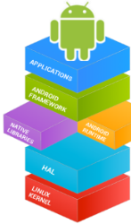



Mobile Application Development (COS7025-B) Designing Mobile Apps using Android Introduction to Fragments
Karim Hammoud Sadik
Lecture #6
Android Studio

Slide 2
Contents
Activities and connection with fragments
Fragment lifecycle
Communication between fragments/activities
UI components

Slide 3
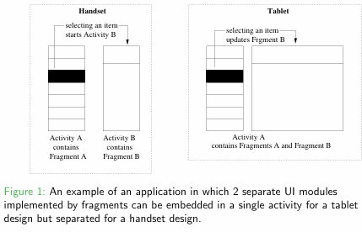
What are Fragments?
Using an activity a user can perform a single task per screen. This might not be necessarily ideal, especially for larger screens.
A Fragment (from Android 3.0- API 11) represents a behaviour or a portion of user interface in an Activity.
Multiple fragments can be used in a single activity to build a multi-pane UI.
Fragments can be re-used across multiple activities.
A fragment has to be embedded within an activity and its lifecycle is affected by the activity’s lifecycle
Fragments | Android Developers

Slide 4
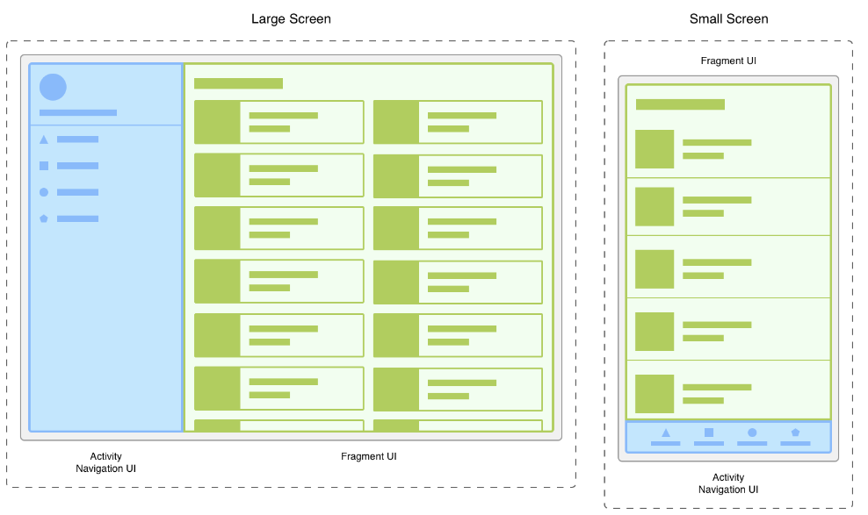
What are Fragments?

Slide 5
Supporting UI flexibility: Issue with Activities
Activities were not built to provide this flexibility.
An activity is tightly coupled with its view. The view that the activity inflates in the call to setContentView(…) is tied to the activity ’til death do them part.
@Override
protected void onCreate(Bundle savedInstanceState) {
super.onCreate(savedInstanceState);
setContentView(R.layout.activity_quiz);
TextView mTextView = (TextView)findViewById(R.id.false_button);
mTrueButton = (Button)findViewById(R.id.true_button);
mTrueButton.setOnClickListener(new View.OnClickListener() {
@Override
public void onClick(View v) {
Toast.makeText(QuizActivity.this,
R.string.incorrect_toast, Toast.LENGTH_SHORT)
.show();
}
});
mFalseButton = (Button)findViewById(R.id.false_button);
mFalseButton.setOnClickListener(new View.OnClickListener() {
@Override
public void onClick(View v) {
Toast.makeText(QuizActivity.this,
R.string.correct_toast, Toast.LENGTH_SHORT)
.show();
}
});
}

Slide 6
Supporting UI flexibility: Issue with Activities
Activities were not built to provide this flexibility.
An activity is tightly coupled with its view. The view that the activity inflates in the call to setContentView(…) is tied to the activity ’til death do them part.
You cannot swap out an activity’s entire view (without destroying the activity) or pass a view from one activity to another at runtime. This is the law of Android.
Work around is : using fragments with the activities

Slide 7
Creating a Fragment
A class has to be created which is a subclass of class Fragment or another subclass of class Fragment.
The following lifecycle methods have to be implemented at least:
onCreate(): Called when creating the fragment. Initialize essential components of the fragment that you want to retain when the fragment is paused or stopped, then resumed.
onCreateView(): Called it is time for the fragment to draw its UI.
onPause(): First indication that the user is leaving the fragment (though it does not always mean the fragment is being destroyed). Commit any changes that should be keep on beyond the current user session (because the user might not come back)

Slide 8
Subclasses of class Fragment
Common subclasses of class Fragment which you might want to subclass to create your own fragment:
DialogFragment
ListFragment
PreferenceFragment

Slide 9
Adding a user interface to a Fragment
public class ExampleFragment extends Fragment {
public View onCreateView(LayoutInflater inflater,
ViewGroup container,
Bundle savedInstanceState) {
// Inflate the layout for this fragment
return inflater.inflate(R.layout.example_fragment, container, false); }
}
Note: If your fragment is a subclass of ListFragment, you do not need to override this as the parent class implementation creates and returns a ListView.
Adding a Fragment to an activity
Statically (using the activity’s XML layout files)
Programmatically

Slide 10
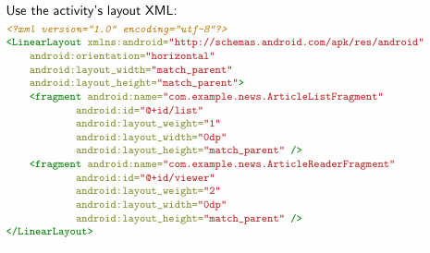
Statically adding a Fragment

Slide 11
Programmatically adding a Fragment
Specify a ViewGroup to add the fragment:
FragmentManager fragmentManager = getFragmentManager();
FragmentTransaction fragmentTransaction = fragmentManager.beginTransaction();
ExampleFragment fragment = new ExampleFragment();
fragmentTransaction.add(R.id.fragment_container, fragment);
/* optionally add the transaction to the back stack in case the user presses the Back button to get back to the fragment */
transaction.addToBackStack(null);
// Commit the transaction
fragmentTransaction.commit();

Slide 12
Replacing or removing a Fragment
The replace() or remove() methods can be used instead of add(). For example, to replace whatever fragment is in the fragment container view:
// Create new fragment and transaction
Fragment newFragment = new ExampleFragment();
FragmentTransaction transaction = getFragmentManager().beginTransaction();
/* Replace whatever is in the fragment_container view with this fragment and add the transaction to the back stack */
transaction.replace(R.id.fragment_container, newFragment);
transaction.addToBackStack(null);
// Commit the transaction
transaction.commit()

Slide 13
How a Fragment communicates with its activity?
Although a Fragment is implemented independently from its Activity and can be used within multiple activities, there are 2 ways in which it can communicate with the activity it is embedded into:
Use the getActivity() method
View listView = getActivity().findViewById(R.id.list);
Similarly the activity can obtain a reference to the fragment using
findFragmentById() or findFragmentByTag():
ExampleFragment fragment = (ExampleFragment)
getFragmentManager().findFragmentById(R.id.example_fragment);
Create event callbacks to the activity using an interface

Slide 14
Example of creating event callbacks to the activity
A news application has two fragments in an activity:
Frament A to show a list of articles
Fragment B to display an article
Fragment A must tell the activity when a list item is selected so that the activity can tell fragment B to display the article.
The OnArticleSelectedListener interface is declared inside fragment A:
public class FragmentA extends ListFragment { ...
// Container Activity must implement this interface
public interface OnArticleSelectedListener {
public void onArticleSelected(int index);
}
……
}

Slide 15
Example for using Fragments
Portrait mode for the Shakespeare example.
Portrait mode for the Shakespeare example shown once a title has been selected.

Slide 16
Example of creating event callbacks to the activity (cont’d)
To ensure that the host activity implements this interface, fragment As onAttach() callback method (which the system calls when adding the fragment to the activity) and using the instance of OnArticleSelectedListener by casting the Activity that is passed into onAttach():
public class FragmentA extends ListFragment {
OnArticleSelectedListener mListener;
...
public void onAttach(Activity activity) {
super.onAttach(activity);
try {
mListener = (OnArticleSelectedListener) activity;
} catch (ClassCastException e) {
throw new ClassCastException(activity.toString() + " must implement OnArticleSelectedListener");
}
}
...
}

Slide 17
Example of creating event callbacks to the activity (cont’d)
public static class FragmentA extends ListFragment {
OnArticleSelectedListener mListener;
...
public void onListItemClick(ListView l, View v, int position, long id) {
// Send the event and Uri to the host activity
mListener.onArticleSelected(position);
}
...
}
Now the activity know which article was selected (i.e. it knows the position of the list item selected) and can instruct from within its implementation of the onArticleSelected(int pos) method the second Fragment B to display the selected article

Slide 18
Fragments in the API
Fragments were introduced in API level 11 along with the first Android tablets and the sudden need for UI flexibility.
Fortunately, in the case of fragments, ensuring backwards-compatibility is relatively easy: you simply use the fragment-related classes found in Android’s support library.
The support library includes a Fragment class (android.support.v4.app.Fragment) that you can use on any Android device running API level 4 or higher.

Slide 19
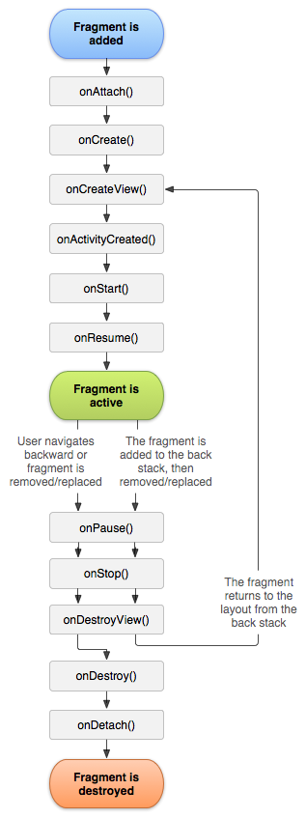
Fragment Lifecycle
You will learn about using these methods as you go along

Slide 20
Fragment Lifecycle
onCreateView()
The system calls this when it's time for the fragment to draw its user interface for the first time. To draw a UI for your fragment, you must return a View from this method that is the root of your fragment's layout. You can return null if the fragment does not provide a UI.
@Override
public View onCreateView(LayoutInflater inflater, ViewGroup container, ) {
View view = inflater.inflate(R.layout.fragment_task_list, container, false);
return view
}
Fragments cannot put their views on screen.
To realize your efforts, you first have to add a Fragment to an Activity. (Remember: An activity can have many fragments)

Slide 21
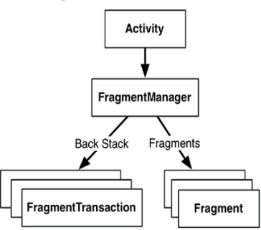
Fragment Manager
The FragmentManager is responsible for managing your fragments and adding their views to the activity’s view hierarchy.
The FragmentManager handles two things: a list of fragments and a back stack of fragment transactions.

Slide 22
Few other scenarios
A news application can use one fragment to show a list of articles on the left and another fragment to display an article on the right—both fragments appear in one activity, side by side, and each fragment has its own set of lifecycle callback methods and handle their own user input events.
Thus, instead of using one activity to select an article and another activity to read the article, the user can select an article and read it all within the same activity.
What another example scenario you can think of?
Login/register screen App
Email app

Slide 23
Example for using Fragments
An activity displays a list of Shakespeare play titles using a fragment. A second fragment is used to show a summary of the play when selected from the list.
Based on the screen type (landscape or portrait) the 2 fragments can be displayed at once (landscape) or a second activity created which displays the second fragment.
Portrait mode for the Shakespeare example.
Portrait mode for the Shakespeare example shown once a title has been selected.

Slide 24
Example for using Fragments
Landscape mode for the Shakespeare example.

Slide 25
Example for using Fragments (cont’d)
The MainActivity:
package com.example.frgmentexample;
import android.os.Bundle;
import android.app.Activity;
import android.view.Menu;
public class MainActivity extends Activity {
protected void onCreate(Bundle savedInstanceState) {
super.onCreate(savedInstanceState);
setContentView(R.layout.activity_main);
}
public boolean onCreateOptionsMenu(Menu menu) {
/* Inflate the menu; this adds items to the action bar if it is present. */
getMenuInflater().inflate(R.menu.main, menu);
return true;
}
}

Slide 26
Example for using Fragments (cont’d)
The layout of the main activity (portrait mode):
<FrameLayout xmlns:android="http://schemas.android.com/apk/res/android"
android:layout_width="match_parent"
android:layout_height="match_parent">
<fragment class="com.example.frgmentexample.TitlesFragment"
android:id="@+id/titles"
android:layout_width="match_parent"
android:layout_height="match_parent" />
</FrameLayout>

Slide 27
Example for using Fragments (cont’d)
The layout of the main activity (landscape mode - it should be placed in the res/layout-land directory):
<LinearLayout xmlns:android="http://schemas.android.com/apk/res/android"
android:orientation="horizontal"
android:layout_width="match_parent"
android:layout_height="match_parent">
<fragment class="com.example.frgmentexample.TitlesFragment"
android:id="@+id/titles"
android:layout_weight="1"
android:layout_width="0px"
android:layout_height="match_parent" />
<FrameLayout android:id="@+id/details"
android:layout_weight="1"
android:layout_width="0px"
android:layout_height="match_parent"/>
</LinearLayout>

Slide 28
Example for using Fragments (cont’d)
package com.example.frgmentexample;
import android.app.FragmentTransaction;
import android.app.ListFragment;
import android.content.Intent;
import android.os.Bundle;
import android.view.View;
import android.widget.ArrayAdapter;
import android.widget.ListView;
public class TitlesFragment extends ListFragment {
boolean mDualPane;
int mCurCheckPosition = 0;
public void onActivityCreated(Bundle savedInstanceState) {
super.onActivityCreated(savedInstanceState);
// Populate list with our static array of titles.
setListAdapter(new ArrayAdapter<String>(getActivity(),
android.R.layout.simple_list_item_activated_1, Shakespeare.TITLES));
// Check to see if we have a frame in which to embed the details
// fragment directly in the containing UI.
View detailsFrame = getActivity().findViewById(R.id.details);
TitlesFragment.java file

Slide 29
Example for using Fragments (cont’d)
mDualPane = detailsFrame != null && detailsFrame.getVisibility() == View.VISIBLE;
if (savedInstanceState != null) {
// Restore last state for checked position.
mCurCheckPosition = savedInstanceState.getInt("curChoice", 0);
}
if (mDualPane) {
// In dual-pane mode, the list view highlights the selected item.
getListView().setChoiceMode(ListView.CHOICE_MODE_SINGLE);
// Make sure our UI is in the correct state.
showDetails(mCurCheckPosition);
}}
public void onSaveInstanceState(Bundle outState) {
super.onSaveInstanceState(outState);
outState.putInt("curChoice", mCurCheckPosition);
}
public void onListItemClick(ListView l, View v, int position, long id) {
showDetails(position);
}

Slide 30
Example for using Fragments (cont’d)
/**
* Helper function to show the details of a selected item, either by displaying a fragment in-place in the current UI, or starting a whole new activity in which it is displayed. */
void showDetails(int index) {
mCurCheckPosition = index;
if (mDualPane) {
// We can display everything in-place with fragments, so update the list to highlight the selected item and show the data.
getListView().setItemChecked(index, true);
// Check what fragment is currently shown, replace if needed.
DetailsFragment details = (DetailsFragment)
getFragmentManager().findFragmentById(R.id.details);
if (details == null || details.getShownIndex() != index) {
// Make new fragment to show this selection.
details = DetailsFragment.newInstance(index);
// Execute a transaction, replacing any existing fragment with this one inside the frame.
FragmentTransaction ft = getFragmentManager().beginTransaction();
ft.replace(R.id.details, details);
ft.setTransition(FragmentTransaction.TRANSIT_FRAGMENT_FADE);
ft.commit();
}

Slide 31
Example for using Fragments (cont’d)
} else {
// Otherwise we need to launch a new activity to display the dialog fragment with selected text.
Intent intent = new Intent();
intent.setClass(getActivity(), DetailsActivity.class);
intent.putExtra("index", index);
startActivity(intent);
}
}
}

Slide 32
Example for using Fragments (cont’d)
package com.example.frgmentexample;
import android.app.Fragment;
import android.os.Bundle;
import android.util.TypedValue;
import android.view.LayoutInflater;
import android.view.View;
import android.view.ViewGroup;
import android.widget.ScrollView;
import android.widget.TextView;
public class DetailsFragment extends Fragment {
/**
* Create a new instance of DetailsFragment, initialized to show the text at index.
*/
public static DetailsFragment newInstance(int index) {
DetailsFragment f = new DetailsFragment();
}
// Supply index input as an argument.
Bundle args = new Bundle(); args.putInt("index", index);
f.setArguments(args);
return f;
}
DetailsFragment.java file

Slide 33
Example for using Fragments (cont’d)
public int getShownIndex() {
return getArguments().getInt("index", 0);
}
public View onCreateView(LayoutInflater inflater, ViewGroup container, Bundle savedInstanceState) {
if (container == null) {
// We have different layouts, and in one of them this fragments containing frame doesnt exist. The fragment
// may still be created from its saved state, but there is no reason to try to create its view hierarchy because it
// won’t be displayed. Note this is not needed -- we could just run the code below, where we would create and //return the view hierarchy; it would just never be used.
return null;
}
ScrollView scroller = new ScrollView(getActivity());
TextView text = new TextView(getActivity());
int padding = (int)TypedValue.applyDimension(TypedValue.COMPLEX_UNIT_DIP, 4, getActivity().getResources().getDisplayMetrics());
text.setPadding(padding, padding, padding, padding);
scroller.addView(text);
text.setText(Shakespeare.DIALOGUE[getShownIndex()]);
return scroller;
}

Slide 34
Example for using Fragments (cont’d)
package com.example.frgmentexample;
public final class Shakespeare {
/**
* Our data, part 1.
*/
public static final String[] TITLES =
{
"Henry IV (1)",
"Henry V",
"Henry VIII",
"Richard II",
"Richard III",
"Merchant of Venice",
"Othello",
"King Lear"
};
Shakespeare.java file:

Slide 35
Example for using Fragments (cont’d)
/**
* Our data, part 2.
*/
public static final String[] DIALOGUE =
{
"So shaken as we are, so wan with care," + "Find we a time for frighted peace to pant," +
"And breathe short-winded accents of new broils" + "To be commenced in strands afar remote.",
"Hear him but reason in divinity," + "And all-admiring with an inward wish" +
"You would desire the king were made a prelate:" + "Hear him debate of commonwealth affairs,",
"I come no more to make you laugh: things now," + "That bear a weighty and a serious brow," +
"Sad, high, and working, full of state and woe," + "Such noble scenes as draw the eye to flow,",
"First, heaven be the record to my speech!" + "In the devotion of a subjects love," +
"Tendering the precious safety of my prince," + "And free from other misbegotten hate," +
"Come I appellant to this princely presence.", "Now is the winter of our discontent" +
"Made glorious summer by this sun of York;" + "And all the clouds that lourd upon our house" +
"In the deep bosom of the ocean buried.", "To bait fish withal: if it will feed nothing else," +
"it will feed my revenge. He hath disgraced me, and" + "hindered me half a million; laughed at my losses," + "mocked at my gains, scorned my nation, thwarted my" + "bargains, cooled my friends, heated mine" + "enemies; and whats his reason? I am a Jew. Hath", "Virtue! a fig! tis in ourselves that we are thus" +
"or thus. Our bodies are our gardens, to the which" + "our wills are gardeners:", "Blow, winds, and crack your cheeks! rage! blow!" + "You cataracts and hurricanoes, spout" + "Till you have drenchd our steeples"
};
}

Slide 36
Example for using Fragments (cont’d)
package com.example.frgmentexample;
import android.app.Activity;
import android.content.res.Configuration;
import android.os.Bundle;
public class DetailsActivity extends Activity {
protected void onCreate(Bundle savedInstanceState) {
super.onCreate(savedInstanceState);
if (getResources().getConfiguration().orientation == Configuration.ORIENTATION_LANDSCAPE) {
// If the screen is now in landscape mode, we can show the dialog in-line with the list so we don’t need this activity.
finish();
return;
}
if (savedInstanceState == null) {
// During initial setup, plug in the details fragment.
DetailsFragment details = new DetailsFragment();
details.setArguments(getIntent().getExtras());
getFragmentManager().beginTransaction().add(android.R.id.content, details).commit();
}
}
}
In the manifest file add the DetailsActivity activity and change the minimum SDK version to 11.
DetailsActivity.java file

Slide 37
Any Questions?

